Slide 1

Smart Intrusion Detection with AI and Deep Learning for Enhanced Network Security

Slide 2
Project Team
Somu Anusha-21981A4652
Moningi Satish Kumar-21981A4637
Dasari Vinayak Aditya-21981A4615
Uppada Praveen Kumar-22985A4606
Under the esteemed guidance of Mrs. P.Sowjanya Madam

Slide 3




Abstract Overview
Network Monitoring
The Intrusion Detection System (IDS) continuously monitors network traffic to identify any suspicious or anomalous activities that could indicate a potential security breach.
Machine Learning
Advanced machine learning and deep learning techniques are employed to enhance the accuracy and responsiveness of the IDS in detecting complex network intrusions.
Improved Security
The goal is to develop a robust IDS that can effectively protect networks, especially in challenging environments like IoT and wireless networks, from various cyber threats.

Slide 4
Literature Survey
SL Number
Author
Year
Title
Algorithms
Link
1
ZAHEDI AZAM
2023
Comparative Analysis of Intrusion Detection Systems and Machine Learning-Based Model Analysis Through Decision Tree
Intrusion detection system, machine learning, inductive learning, DDoS attacks, decision tree, supervised and unsupervised learning.
Link 1
2
Astha Tiwari
2022
INTRUSION DETECTION SYSTEM
JAVA, Intrusion Detection System, IDE, Tomcat Server, Anomaly based IDS , Signature based IDS etc
Link 2
3
Nidhi Kumari
2022
Intrusion Detection System Using Machine Learning: An Overview
Intrusion detection, Security, Machine Learning, Data mining
Link 3

Slide 5
4
Dr. Varanasi Usha Bala
2020
Intrusion Detection System with Machine Learning Algorithms and
Intrusion Detection System (IDS), Machine Learning, Correlation Engine, Vulnerability Assessment, True Alarm, False Positive
Link 4
5
Malek Barhoush
Network Intrusion Detection System: Machine Learning Approach
supervised learning" algorithms, including: "artificial neural network (ANN), Bayesian statistics, Gaussian process regression, lazy learning, nearest neighbor algorithm, support vector machine (SVM)
link 5
​
6
SATISH KUMAR
2021
Research Trends in Network-Based Intrusion Detection Systems: A Review
Citation, Machine Learning, Bio-inspired, Intrusion Detection System, NIDS, Dataset
Link 6

Slide 6

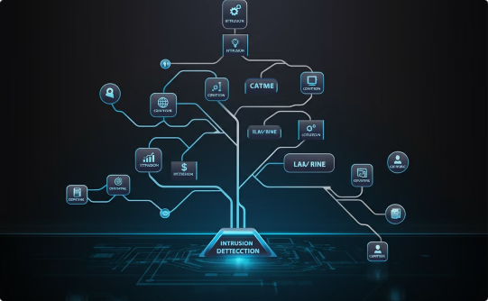

Existing Systems and Techniques
Support Vector Machines (SVM)
Decision Trees
K-Nearest Neighbors (KNN)
Decision trees are another traditional approach, building a hierarchical model of rules to classify network traffic as normal or malicious based on various features and thresholds.
KNN is a simple yet effective technique that identifies intrusions by comparing network traffic features to a database of known normal and attack patterns.
SVM is a classical machine learning technique that constructs hyperplanes to separate different classes of data points, effectively identifying patterns in network traffic to detect intrusions.

Slide 7

Drawbacks of Existing Systems
1
Lack of Scalability
2
High False Alarm Rates
Many existing intrusion detection systems struggle to keep up with the increasing volume and complexity of network traffic, leading to performance issues and potential security vulnerabilities.
Existing IDS solutions often generate an excessive number of false positive alerts, overwhelming security teams and reducing the effectiveness of threat detection.
3
Limited Adaptability
4
Lack of Contextual Analysis
Traditional IDS models are often rigid and fail to adapt to evolving cyber threats, requiring frequent manual updates and configuration changes.
Many existing IDS lack the ability to correlate and analyze security events in the broader context of an organization's IT infrastructure, limiting their ability to identify complex, multi-stage attacks.

Slide 8
Proposed Systems and Techniques
Cutting-Edge Machine Learning
Modern Datasets
Adaptive Learning
The system will be trained on comprehensive, up-to-date datasets like CICIDS 2017 and UNSW-NB15, which capture realistic network traffic with a diverse set of normal and malicious activities. Additionally, it will leverage datasets focused on IoT and wireless network traffic to address emerging security challenges.
The proposed IDS will employ continuously learning algorithms that can adapt to evolving network threats and attack patterns, ensuring robust protection against both known and novel intrusion attempts.
The proposed IDS system will leverage state-of-the-art deep learning techniques, such as Convolutional Neural Networks (CNNs) and Recurrent Neural Networks (RNNs) with Long Short-Term Memory (LSTMs), to accurately detect a wide range of intrusion attempts, including DoS, DDoS, and brute force attacks.

Slide 9
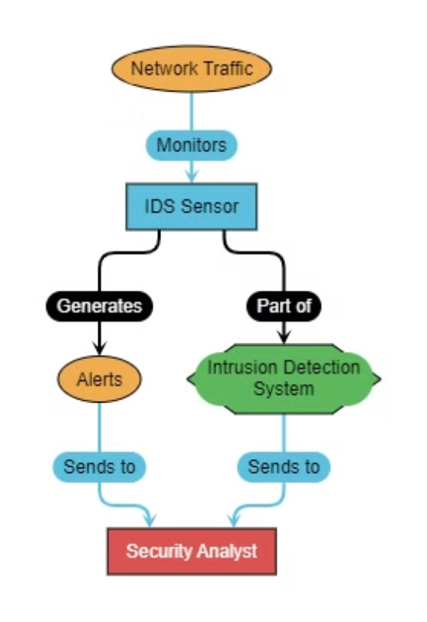
Architecture

Slide 10
Problem Statement
Limitations of Existing IDS
Need for Advanced Solutions
Current Intrusion Detection Systems often struggle to keep up with the evolving landscape of cyber threats. They may rely on outdated signatures or lack the flexibility to adapt to new attack vectors. This can leave organizations vulnerable to sophisticated, unknown threats that bypass traditional detection methods.
There is a growing need for more robust, intelligent Intrusion Detection Systems that can leverage machine learning, behavioral analysis, and real-time threat intelligence to identify and mitigate advanced cyber attacks. These next-generation IDS solutions must be able to detect anomalies, respond dynamically, and provide comprehensive visibility into the security posture of the organization.

Slide 11



Proposed Solutions
Hybrid IDS
1
Combining signature-based and anomaly-based detection for improved accuracy
Machine Learning
2
Leveraging advanced algorithms to detect complex attack patterns
Adaptive Profiling
3
Dynamically adjusting detection models to adapt to evolving threats
The proposed solutions for the Intrusion Detection System (IDS) leverage a hybrid approach, cutting-edge machine learning techniques, and adaptive profiling to address the shortcomings of existing systems. By blending signature-based and anomaly-based detection, the hybrid IDS can identify both known and unknown threats with greater precision. Advanced machine learning algorithms will enable the IDS to detect complex attack patterns that evade traditional methods. Additionally, the system will dynamically adjust its models to adapt to the evolving threat landscape, ensuring continuous and robust protection.

Slide 12
References
Zahedi Azam (2023): Comparative Analysis of Intrusion Detection Systems and Machine Learning-Based Model Analysis Through Decision Tree
Algorithms: Intrusion detection system, machine learning, inductive learning, DDoS attacks, decision tree, supervised and unsupervised learning.
Link 1
Astha Tiwari (2022): Intrusion Detection System
Algorithms: JAVA, Intrusion Detection System, IDE, Tomcat Server, Anomaly based IDS, Signature based IDS etc.
Link 2
Nidhi Kumari (2022): Intrusion Detection System Using Machine Learning: An Overview
Algorithms: Intrusion detection, Security, Machine Learning, Data mining.
Link 3

Slide 13
Dr. Varanasi Usha Bala (2020): Intrusion Detection System with Machine Learning Algorithms and
Algorithms: Intrusion Detection System (IDS), Machine Learning, Correlation Engine, Vulnerability Assessment, True Alarm, False Positive.
Link 4
Malek Barhoush: Network Intrusion Detection System: Machine Learning Approach
Algorithms: supervised learning algorithms, including: artificial neural network (ANN), Bayesian statistics, Gaussian process regression, lazy learning, nearest neighbor algorithm, support vector machine (SVM).
Link 5
Satish Kumar (2021): Research Trends in Network-Based Intrusion Detection Systems: A Review
Algorithms: Citation, Machine Learning, Bio-inspired, Intrusion Detection System, NIDS, Dataset.
Link 6

Slide 14
Thank You

